Slide 1

Power BI
Manager Guide
Activity Book
Said Fawzy

Slide 2
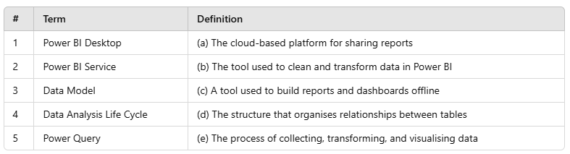
CHAPTER 1
Activity 1: Matching Terms with Definitions.
Instructions: Match each Power BI term with its correct definition by writing the corresponding letter in the blank

Slide 3
CHAPTER 1
Activity 2: Arrange the Steps in the Data Analysis Life Cycle
Data Collection
Data Modeling
Data Transformation
Data Visualization
Sharing & Collaboration
1
2
3
4
5

Slide 4
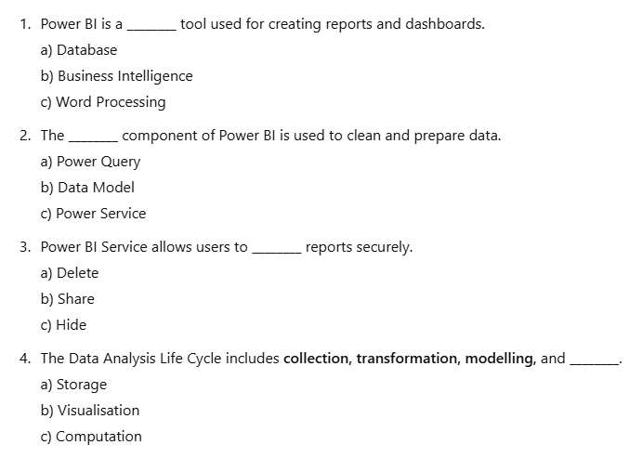
CHAPTER 1
Activity 3: Multiple Choice – Fill in the Blanks
Instructions: Choose the correct answer from the options provided

Slide 5






CHAPTER 1
Activity 4: Drag to right places

Slide 6






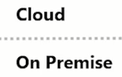

CHAPTER 1
Activity 5: Drag to right places

Slide 7
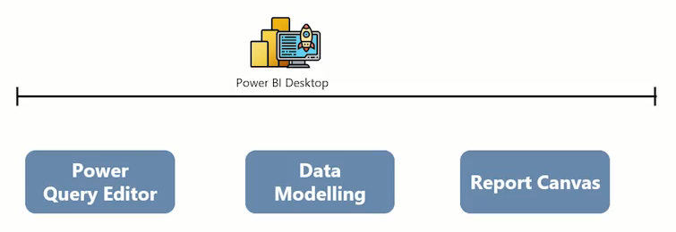
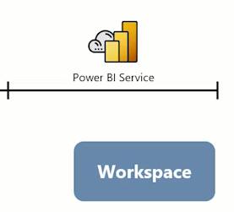
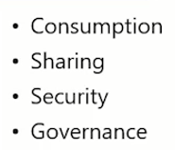

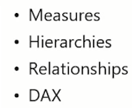

CHAPTER 1
Activity 6: Drag to Right Place

Slide 8
CHAPTER 6
Activity 1: Designing Your Own Dashboard
Use the Excel file provided for this Activity
Step 1: Define Your Dashboard
Each group discusses and identifies a key report they need in their work.
Give them a few examples (e.g., project progress tracking, financial performance, resource allocation).
Step 2: Identify Required Fields
Groups list all fields they need for the dashboard.
Each field should have:
Field Name
Data Type (e.g., Text, Number, Date, Boolean)
Source (e.g., Excel, Database, API)
Step 3: Define Charts and Visuals
For each visual they want to include, they should specify:
Chart Title
Visualization Type (e.g., Bar Chart, Pie Chart, Line Chart)
Fields Used (X-Axis, Y-Axis, Filters)
Any calculated measures (e.g., Sum, Average, Percentage)

Slide 9
CHAPTER 6
Activity 1: Designing Your Own Dashboard (Cont.)
Step 4: Present the Dashboard Plan
Each group presents their dashboard idea and justifies their choices.
Other groups can provide feedback or suggestions.
Use the Excel file provided for this Activity

